Slide 1
Detection of Deepfakes
Speech Group 22/05/2024
Anthony White

Slide 2
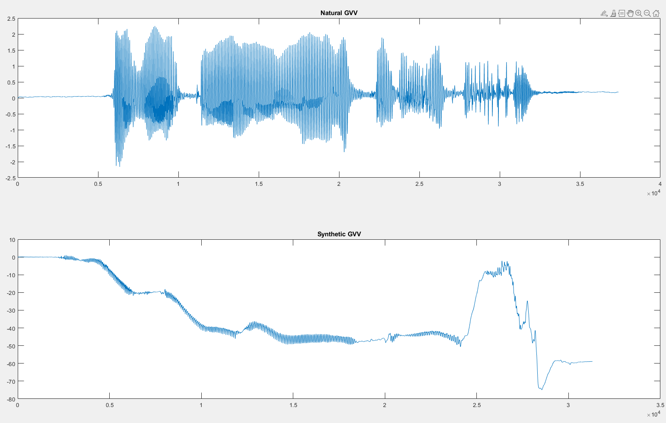
Plots from two weeks ago

Slide 3
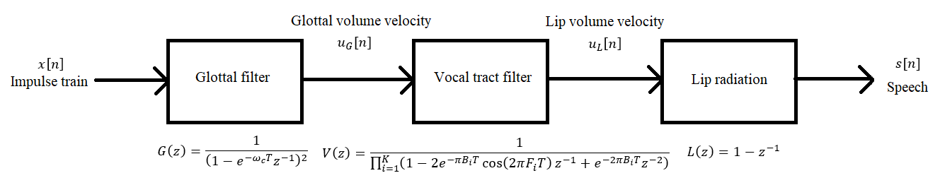
Linear Speech Production Model

Slide 4
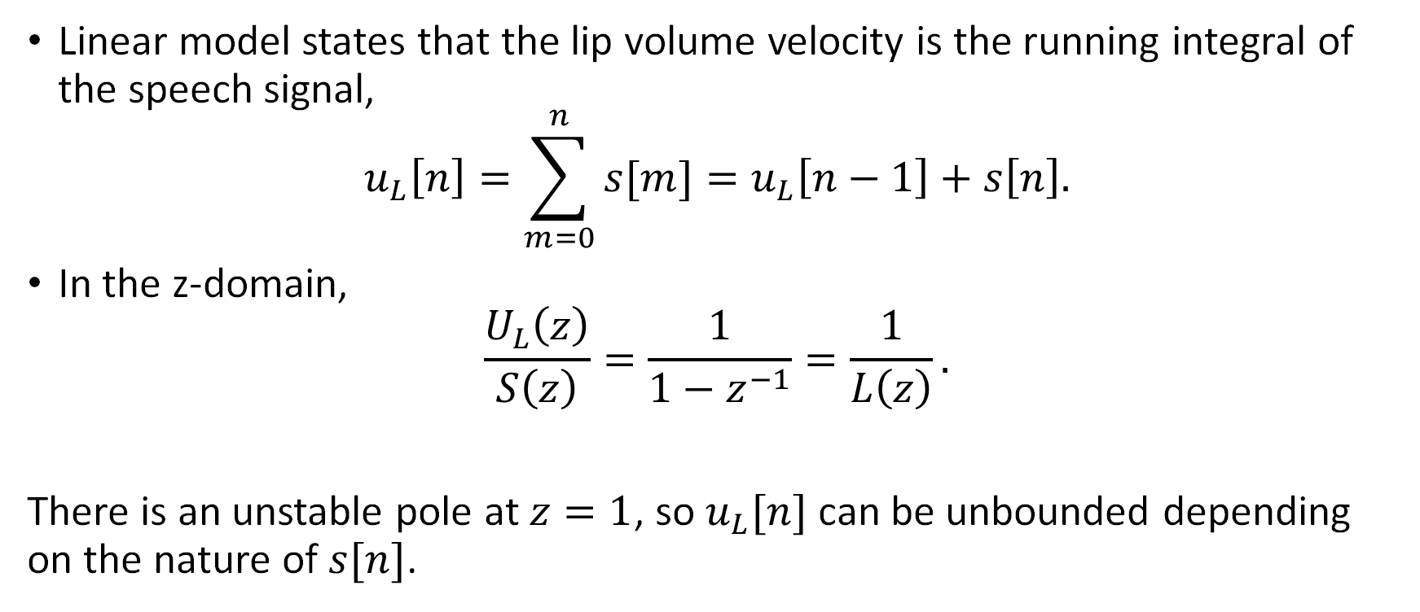
Lip Volume Velocity
Linear model states that the lip volume velocity is the running integral of the speech signal,
$$u_{L}\left[n\right]=\sum_{m=0}^{n}{s[m]}=u_{L}\left[n−1\right]+s\left[n\right].$$
In the z-domain,
$$\frac{U_{L}\left(z\right)}{S\left(z\right)}=\frac{1}{1−z^{−1}}=\frac{1}{L\left(z\right)}.$$
There is an unstable pole at $z=1$, so $u_{L}[n]$ can be unbounded depending on the nature of $s[n]$.

Slide 5
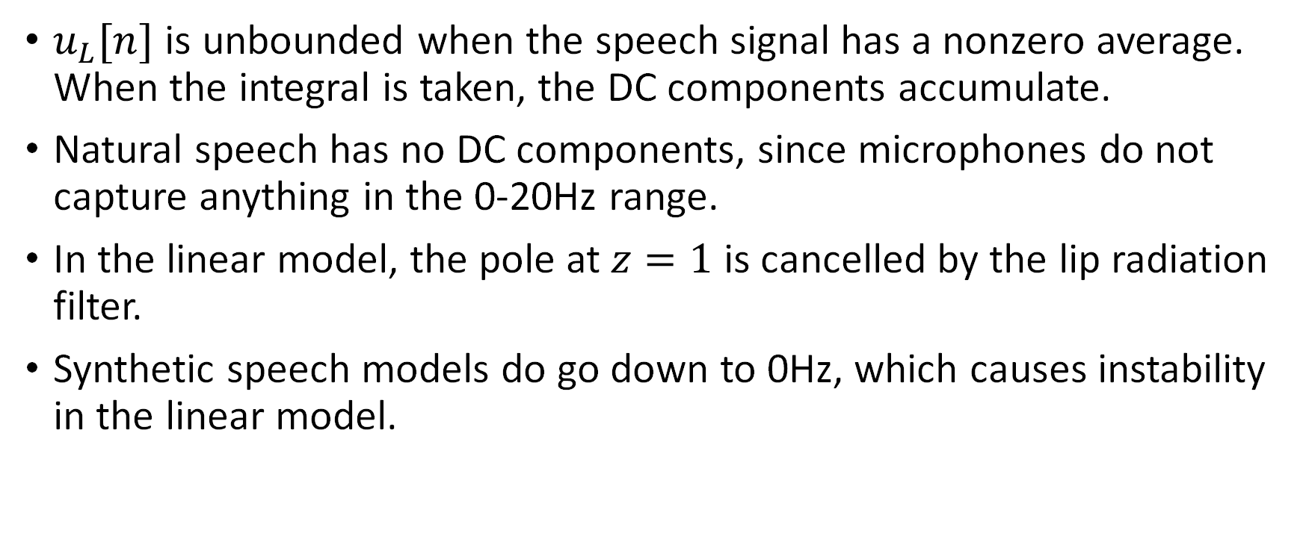
Lip Volume Velocity
$u_{L}[n]$ is unbounded when the speech signal has a nonzero average. When the integral is taken, the DC components accumulate.
Natural speech has no DC components, since microphones do not capture anything in the 0-20Hz range.
In the linear model, the pole at $z=1$ is cancelled by the lip radiation filter.
Synthetic speech models do go down to 0Hz, which causes instability in the linear model.

Slide 6
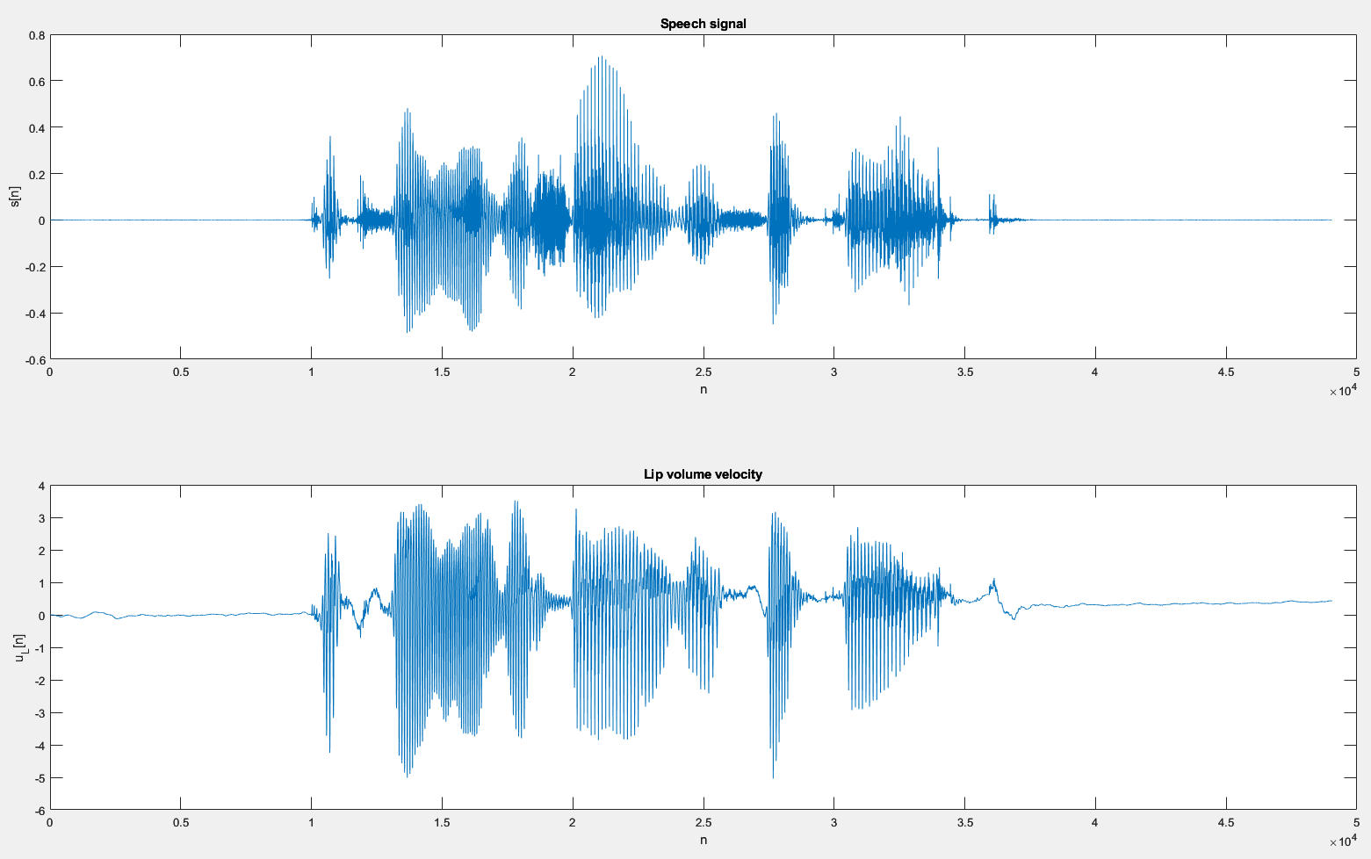
Natural Speech

Slide 7
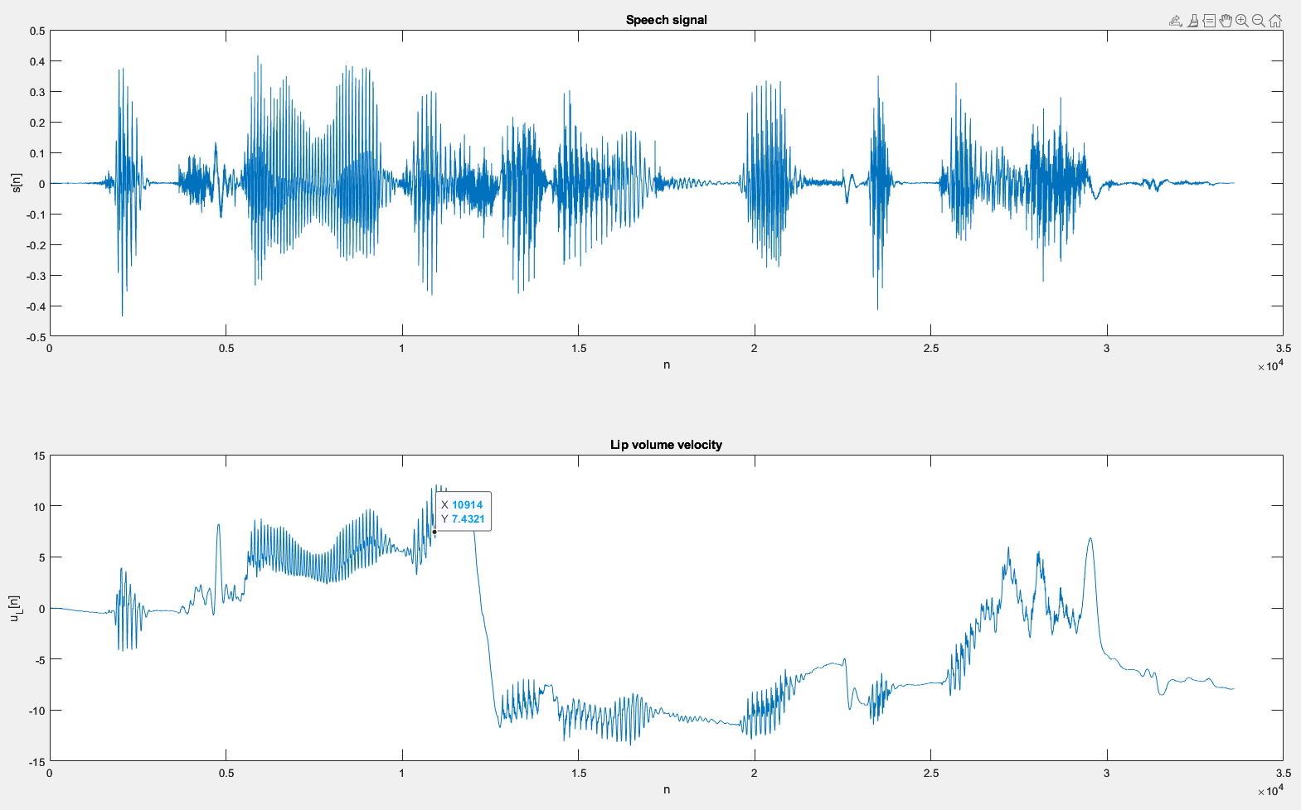
Tacotron 2 Male

Slide 8
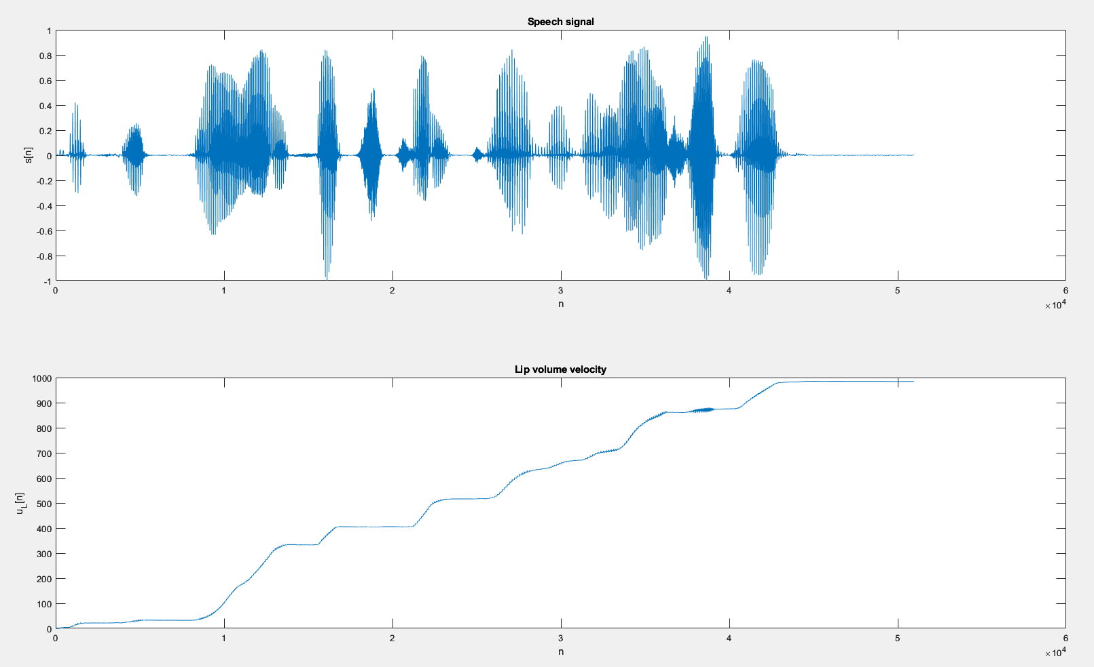
MaryTTS Male

Slide 9
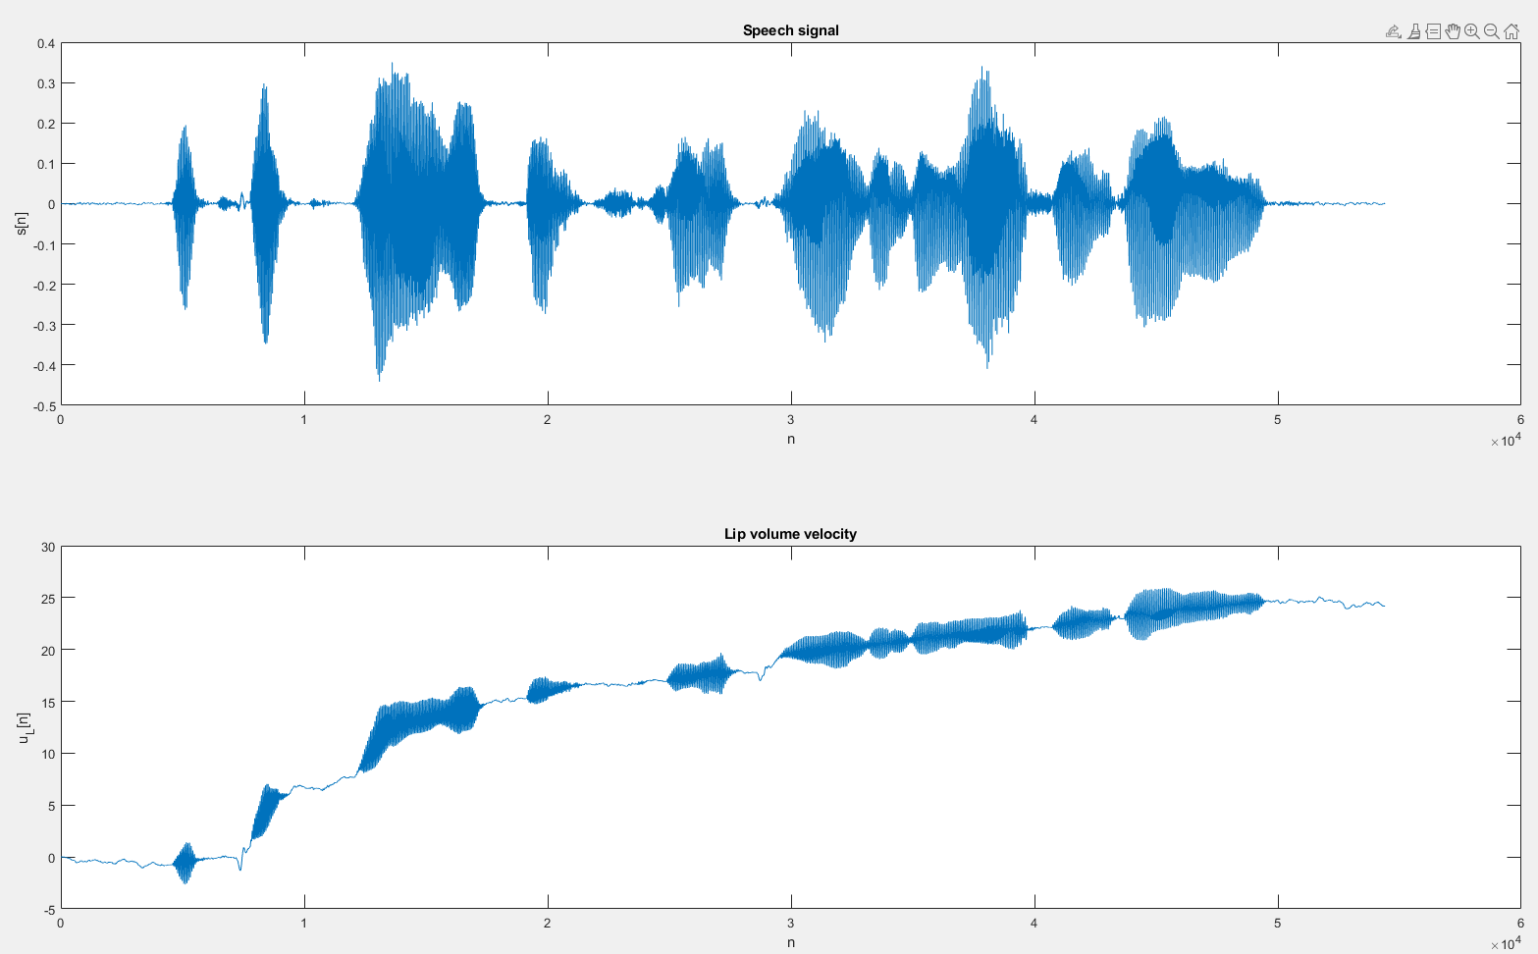
Festival Female

Slide 10
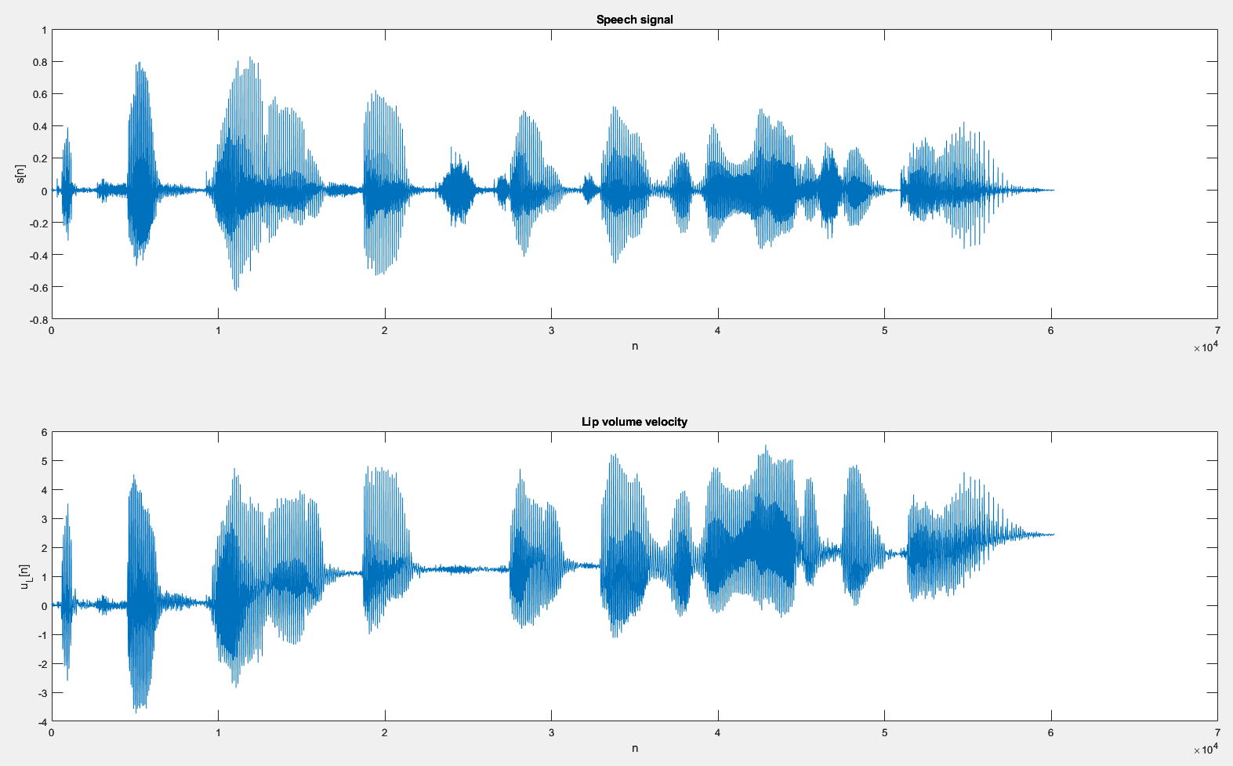
Fastspeech 2 Female (American)

Slide 11
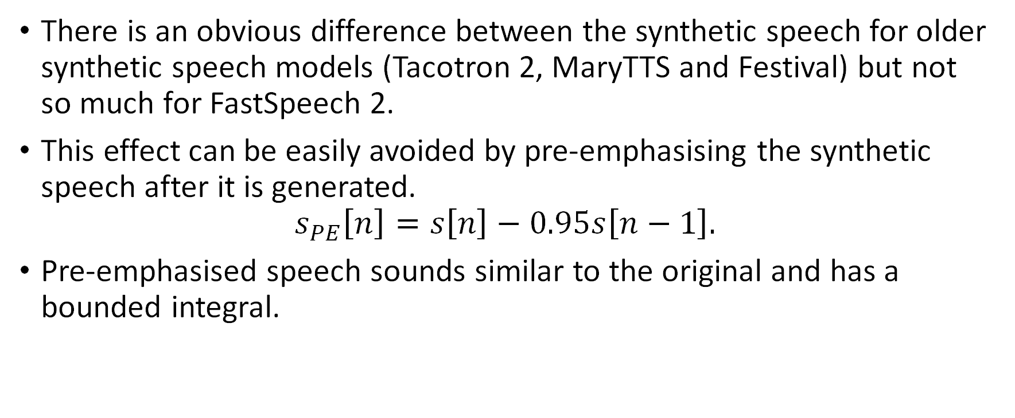
Is this practically useful?
There is an obvious difference between the synthetic speech for older synthetic speech models (Tacotron 2, MaryTTS and Festival) but not so much for FastSpeech 2.
This effect can be easily avoided by pre-emphasising the synthetic speech after it is generated.
$$s_{PE}\left[n\right]=s\left[n\right]−0.95s\left[n−1\right].$$
Pre-emphasised speech sounds similar to the original and has a bounded integral.

